Slide 1
Employment Precarity as a Risk Factor for Adverse Behavioral Health Outcomes
Presentation by Tessa Bonney, MPH, PhD
Assistant Professor at University of Illinois at Chicago School of Public Health Division of Environmental and Occupational Health Sciences
Midwest Injury Prevention Alliance (MIPA) Summit
December 9th, 2021

Slide 2
Career Background
Occupational Health Internship Program (OHIP)
Policy implications of insufficient workplace health & safety protections for temporary workers in Illinois (MPH program)
Health
Labor
Multi-sectoral collaboration to understand precarious employment
Precarious employment as an exposure
Research
Exposure to precarious employment & impacts on physical, mental, and behavioral health.
Precarious work
Health

Slide 3
Precarious Employment
Precarious Work Arrangements
Standard Work Arrangements
Atypical work arrangements
Low wages
No benefits
Lack of protection from termination
Variable work schedules
High psychosocial stress
Disproportionate exposure to risks
Single employer
More likely to have full-time work with benefits
Higher wages
Protections from termination
Predictable work schedules
More likely to be part of a union
Sources: 1 & 2
Notes:
The term “precarious work” has been used to describe work that is “uncertain, unpredictable, and risky from the point of view of the worker.” Temporary work, part-time contract work, and unregulated and informal work, such as day labor and domestic work, are all examples of precarious work arrangements.
Here I’ve contrasted features of standard work arrangements, which are often what we think of as more traditional job situations with regular schedules and a single employer who dictates job tasks, with precarious work arrangements.
Workers in precarious jobs may not know who their employer is; for example, a temp agency may send them out to another company where they’ll actually do the work.
These workers are unlikely to have standard work schedules, have low wages and no benefits, and work in conditions that cause high psychosocial stress.

Slide 4
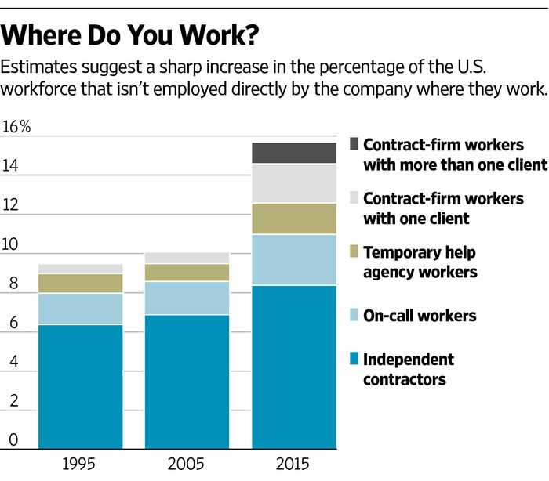
Precarious Employment
Nonstandard, increasingly precarious employment arrangements are on the rise.
These workers experience higher rates of work-related injuries and illnesses than those in standard employment arrangements.
Workers in precarious jobs are more likely to:
Experience decreased economic security
Experience decreased social stability
Sources: 3-5
Notes:
An increasing proportion of the US workforce is employed in non-standard, increasingly precarious work arrangements, which include temporary, part-time, on-call, gig and app-based, on-demand, free-lance, and contract work.
These work arrangements often have unpredictable schedules with variable hours, have multiple employers, and don’t have benefits or opportunities for advancement.
It is well-documented that workers in non-standard employment arrangements have higher rates of work-related injuries and illnesses than workers in standard employment arrangements.
The reasons for these disparities are not always clear – nonstandard workers may be assigned more hazardous tasks, may be reluctant to decline more hazardous work, may lack appropriate training or PPE, etc. and may thus be more exposed to hazards or exposed to hazards in ways that put them at higher risk of injury or illness.

Slide 5
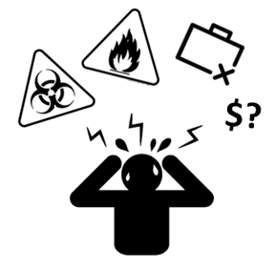
Precarious Employment & Mental Health
There are well-documented associations between:
Job insecurity or job loss and poor mental health
Common mental health disorders and substance use and abuse
Occupational injury, job loss, and substance use
Stressors related to employment precarity likely have cascading effect leading to more stressors which may increase risks for distress and self-medication of distress.
Sources: 6-8

Slide 6
Precarious Employment & Behavioral Health
Boone County Work, Mental Health, and Substance Use Study
Study goals:
Collect in-depth data about employment & behavioral health
Examine the impacts of stressors that stem from employment availability and precarity on behavioral health outcomes
Explore the immediate employment and health impacts of the COVID-19 pandemic experienced by the county's residents
Data collection:
Conducted 45-min. telephone surveys with residents of Boone County who were 18+, employed within previous 24 months, and speak English or Spanish.

Slide 7
Precarious Employment & Behavioral Health
Mental Health assessed via Mental Health Inventory-5 (MHI-5).
MHI-5 scores > 70 are considered “good” mental health; ≤ 70 considered “poor” mental health.
Employment precarity calculated using 10-item measure.
Data from BCWMHSU Study, 2020-2021

Slide 8
Precarious Employment & Substance Use
Alcohol consumption assessed using the Alcohol Use Disorders Identification Test (AUDIT).
Painkiller use assessed using dichotomous item from Alcohol Use Disorder and Associated Disabilities Interview Schedule 5 (AUDADIS-5).
Data from BCWMHSU Study, 2020-2021

Slide 9
Precarious Employment & Occupational Hazards
Greater Lawndale Healthy Work Project
Study goals:
Examine relationships between employment precarity and exposure to occupational hazards in two contiguous high socio-economic hardship neighborhoods in Chicago, Illinois.
Data collection:
Conducted in person surveys with residents of Greater Lawndale (two neighborhoods) who were 18+, employed within previous 24 months in precarious work, and spoke English or Spanish.

Slide 10
Precarious Employment & Occupational Hazards
Data from the Greater Lawndale Healthy Work Project (2018).
Employment precarity calculated using 10-item measure.
Hazard exposure time Likert-scale.
Notes:
(GLHW analysis)

Slide 11
Key Takeaways
Employment precarity is an important risk factor for adverse occupational and behavioral health outcomes.
Precariously employed workers:
Are disproportionately exposed to recognized occupational hazards;
Bear disproportionate burden of injury on the job; and
Are more likely than stably employed workers to report symptoms of distress and hazardous substance use behaviors
Opportunity for researchers and practitioners to consider employment precarity in assessment of injury risk in the workforce.

Slide 12
Funding for Research Works
Funding for the research projects presented here was made possible by the Centers for Disease Control and Prevention National Institute of Occupational Safety and Health under grant numbers U19 OH011232 and OH008672-15. The views expressed here do not necessarily reflect the official policies of the Department of Health and Human Services, nor does the mention of trade names, commercial practices, or organizations imply endorsement by the U.S. Government.

Slide 13
References
Benach J, Muntaner C. Precarious employment and health: developing a research agenda. J. Epidemiol. Community Heal. 2007, 61, 276–7.
Benavides F, Delclos G. Flexible employment and health inequalities. J. Epidemiol. Community Heal. 2005.
Virtanen M, Kivimäki M, Joensuu M, Virtanen P, Elovainio M, Vahtera J. 2005. Temporary employment and health: A review. Int J Epidemiol 34:610–622.
Benach J, Gimeno D, Benavides FG, Martinez JM, Torne MM. 2004. Types of employment and health in the European Union: Changes from 1995 to 2000. Eur J Public Health 14(3):314–321.
Benavides FG, Benach J, Muntaner C, Delclos GL, Catot N, Amable M. 2006. Associations between temporary employment and occupational injury: What are the mechanisms? Occup Environ Med 63(6):416–421.
Olesen, S. C., Butterworth, P., Leach, L. S., Kelaher, M., & Pirkis, J. (2013). Mental health affects future employment as job loss affects mental health: findings from a longitudinal population study. BMC psychiatry, 13(1), 144.
Sullivan, M. D., Edlund, M. J., Zhang, L., Unützer, J., & Wells, K. B. (2006). Association between mental health disorders, problem drug use, and regular prescription opioid use. Archives of internal medicine, 166(19), 2087-2093.
Applebaum, K. M., Asfaw, A., O'Leary, P. K., Busey, A., Tripodis, Y., & Boden, L. I. (2019). Suicide and drug‐related mortality following occupational injury. American journal of industrial medicine, 62(9), 733-741.

